Slide 1
Network Layer in Computer
Networks
Lecture 24
Prepared By:
Dr. Shveta Bansal
Department of Computer Science and Engineering,
Chitkara University, Punjab
Computer Networks _22CS008

Slide 2
Index
Introduction
Basic Operations of Network Layer
IP encapsulation
Characteristics of IP
2. IPv4 Packet Header
Packet header format
Header fields
3. Host Routing
Types of Routing
Popular Routing protocols
4. Distance Vector Routing
5. Link State Routing

Slide 3
1. Introduction
The Network Layer is the third layer of the OSI model.
It handles the service requests from the transport layer and further forwards the service request to the data link layer.
The network layer translates the logical addresses into physical addresses
It determines the route from the source to the destination and also manages the traffic problems such as switching, routing and controls the congestion of data packets.
The main role of the network layer is to move the packets from sending host to the receiving host.
Unlike the transport layer (OSI Layer 4), which manages the data transport between the processes running on each host, network layer communication protocols (i.e., IPv4 and IPv6) specify the packet structure and processing used to carry the data from one host to another host.

Slide 4
Basic Operations of Network Layer
The network layer performs four basic operations-
Addressing end devices - End devices must be configured with a unique IP address for identification on the network.
Encapsulation - The network layer encapsulates the protocol data unit (PDU) from the transport layer into a packet. The encapsulation process adds IP header information, such as the IP address of the source (sending) and destination (receiving) hosts. The encapsulation process is performed by the source of the IP packet.
Routing - The network layer provides services to direct the packets to a destination host on another network. To travel to other networks, the packet must be processed by a router. The role of the router is to select the best path and direct packets toward the destination host in a process known as routing. A packet may cross many routers before reaching the destination host. Each router a packet crosses to reach the destination host is called a hop.
De-encapsulation - When the packet arrives at the network layer of the destination host, the host checks the IP header of the packet. If the destination IP address within the header matches its own IP address, the IP header is removed from the packet. After the packet is de-encapsulated by the network layer, the resulting Layer 4 PDU is passed up to the appropriate service at the transport layer. The de-encapsulation process is performed by the destination host of the IP packet.

Slide 5
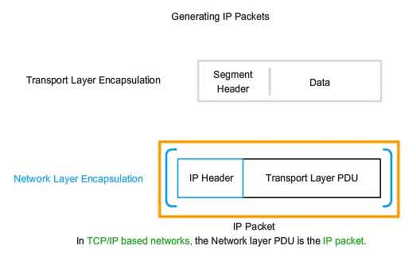
IP Encapsulation
IP encapsulates the transport layer (the layer just above the network layer) segment or other data by adding an IP header. The IP header is used to deliver the packet to the destination host.
Figure 1: IP packet encapsulation from transport layer to network layer

Slide 6
Characteristics of IP
IP was designed as a protocol with low overhead. It provides only the functions that are necessary to deliver a packet from a source to a destination over an interconnected system of networks. The protocol was not designed to track and manage the flow of packets.
These are the basic characteristics of IP:
Connectionless - There is no connection with the destination established before sending data packets.
Best Effort - IP is inherently unreliable because packet delivery is not guaranteed.
Media Independent - Operation is independent of the medium (i.e., copper, fiber-optic, or wireless) carrying the data.

Slide 7
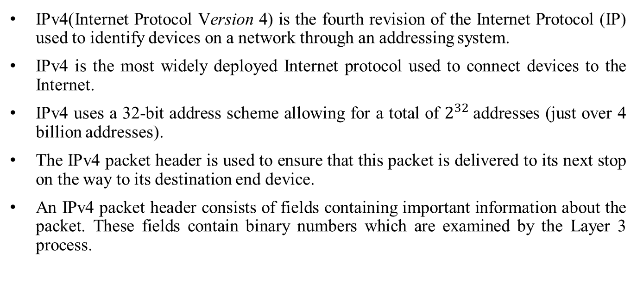
2. IPv4 Packet Header

Slide 8
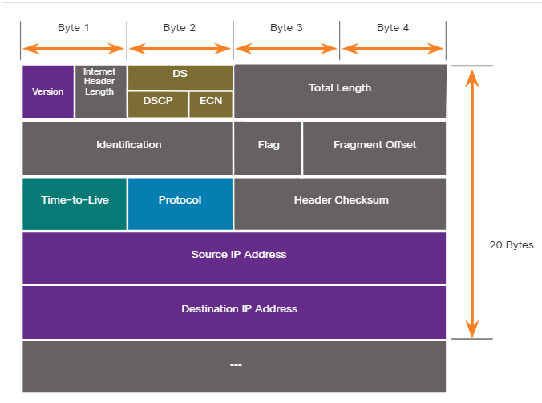
IPv4 Packet Header Format
Figure 2: IPv4 Packet Header Fields

Slide 9
IPv4 Header Fields
VERSION: Version of the IP protocol (4 bits), which is 4 for IPv4
HLEN: IP header length (4 bits), which is the number of 32 bit words in the header. The minimum value for this field is 5 and the maximum is 15.
Type of service: Low Delay, High Throughput, Reliability (8 bits)
Total Length: Length of header + Data (16 bits), which has a minimum value 20 bytes and the maximum is 65,535 bytes.
Identification: Unique Packet Id for identifying the group of fragments of a single IP datagram (16 bits)
Flags: 3 flags of 1 bit each : reserved bit (must be zero), do not fragment flag, more fragments flag (same order)
Fragment Offset: Represents the number of Data Bytes ahead of the particular fragment in the particular Datagram. Specified in terms of number of 8 bytes, which has the maximum value of 65,528 bytes.
Time to live: Datagram’s lifetime (8 bits), It prevents the datagram to loop through the network by restricting the number of Hops taken by a Packet before delivering to the Destination.
Protocol: Name of the protocol to which the data is to be passed (8 bits)
Header Checksum: 16 bits header checksum for checking errors in the datagram header
Source IP address: 32 bits IP address of the sender
Destination IP address: 32 bits IP address of the receiver
Option: Optional information such as source route, record route. Used by the Network administrator to check whether a path is working or not.

Slide 10
3. Host Routing
With both IPv4 and IPv6, packets are always created at the source host. The source host must be able to direct the packet to the destination host. To do this, host end devices create their own routing table.
A host can send a packet to the following:
Itself - A host can ping itself by sending a packet to a special IPv4 address of 127.0.0.1 or an IPv6 address ::1, which is referred to as the loopback interface. Pinging the loopback interface tests the TCP/IP protocol stack on the host.
Local host - This is a destination host that is on the same local network as the sending host. The source and destination hosts share the same network address.
Remote host - This is a destination host on a remote network. The source and destination hosts do not share the same network address.
On a Windows host, the route print or netstat -r command can be used to display the host routing table.

Slide 11
Types of Routing
Static Routing
A static route must be configured manually.
The administrator needs to reconfigure a static route if there is a change in the topology and the static route is no longer viable.
A static route is appropriate for a small network and when there are few or no redundant links.
2. Dynamic Routing
A dynamic routing protocol allows the routers to automatically learn about remote networks, including a default route, from other routers.
Dynamic routing protocols include OSPF and Enhanced Interior Gateway Routing Protocol (EIGRP).
Note: Some routers also use combination od static and dynamic routing protocols.

Slide 12
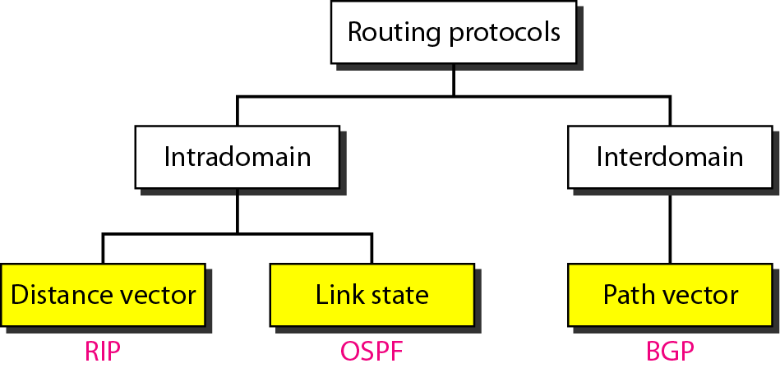
Popular Routing Protocols
Figure 3: Categories of Routing Protocols

Slide 13
4. Distance Vector Routing
A Distance-Vector Routing (DVR) protocol requires that a router inform its neighbors of topology changes periodically. Historically known as the old ARPANET routing algorithm (or known as Bellman-Ford algorithm).
At each step within a router:
Get routing tables from neighbors
Compute distance to neighbors
Compute new routing table
Router transmits its distance vector to each of its neighbors.
Each router receives and saves the most recently received distance vector from each of its neighbors.
A router recalculates its distance vector when:
It receives a distance vector from a neighbor containing different information than before.
It discovers that a link to a neighbor has gone down (i.e., a topology change).The DV calculation is based on minimizing the cost to each destination.

Slide 14
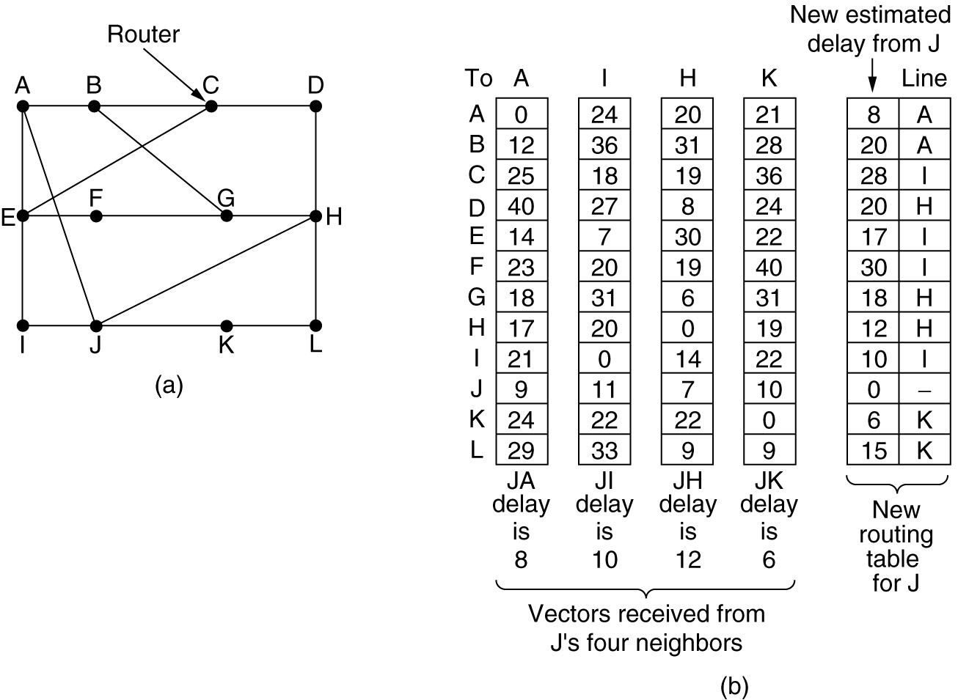
Distance Vector Routing
Figure 4: (a) A subnet. (b) Input from A, I, H, K, and the new
routing table for J.

Slide 15
Drawbacks of Distance Vector Routing
Count to Infinity Problem:
It reacts rapidly to good news, But, leisurely to bad news.
Updates value fast when neighbor is down, but not when neighbor is again up. How?
Lie to neighbor about distance if routing via neighbor
The core of the problem is that when X tells Y that it has a path somewhere, Y has no way of knowing whether it itself is on the path? This is how problem is created.
It does not take bandwidth into account.
Take too long to converge changes in one node to all other nodes.

Slide 16
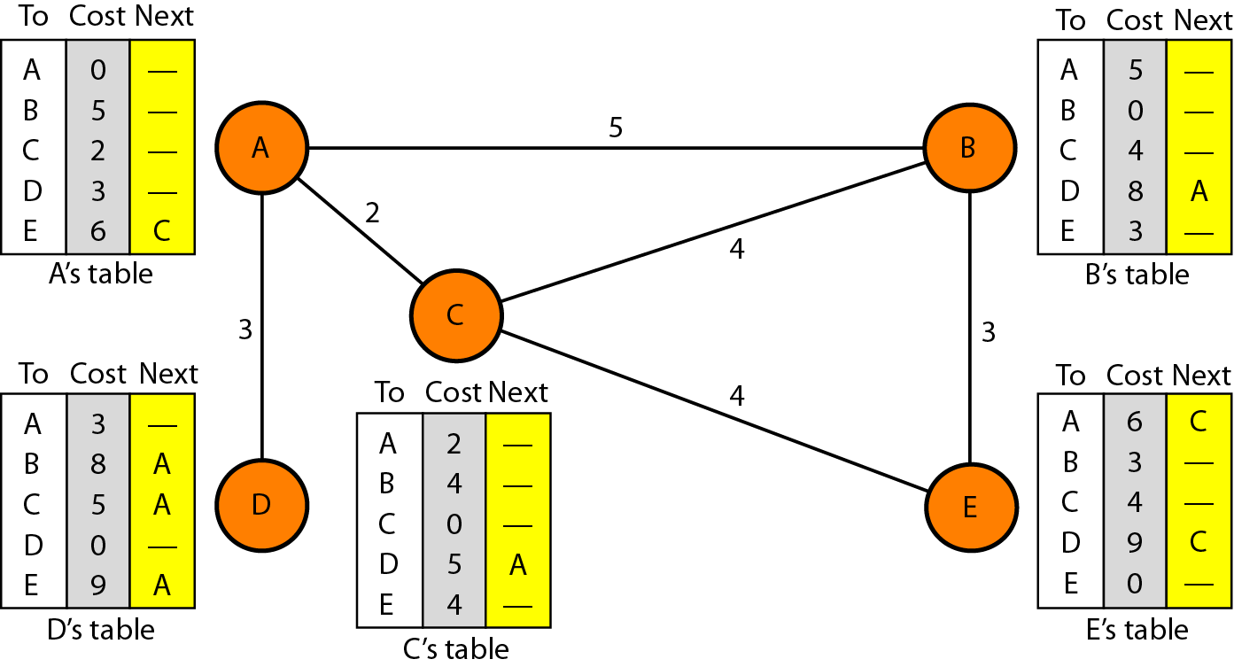
Distance vector routing tables
Figure 5: Routing tables

Slide 17
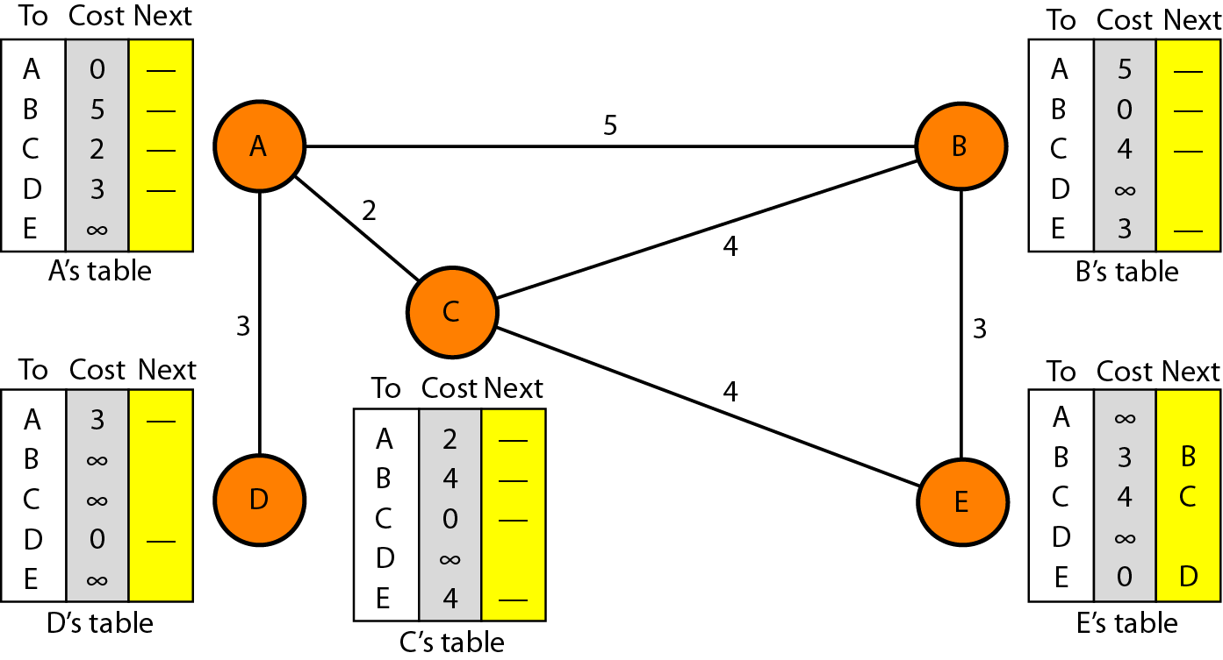
Initialization of tables in distance vector routing
Figure 6: Initialization of Routing tables

Slide 18

Note
In distance vector routing, each node shares its routing table with its
immediate neighbors periodically and when there is a change.

Slide 19
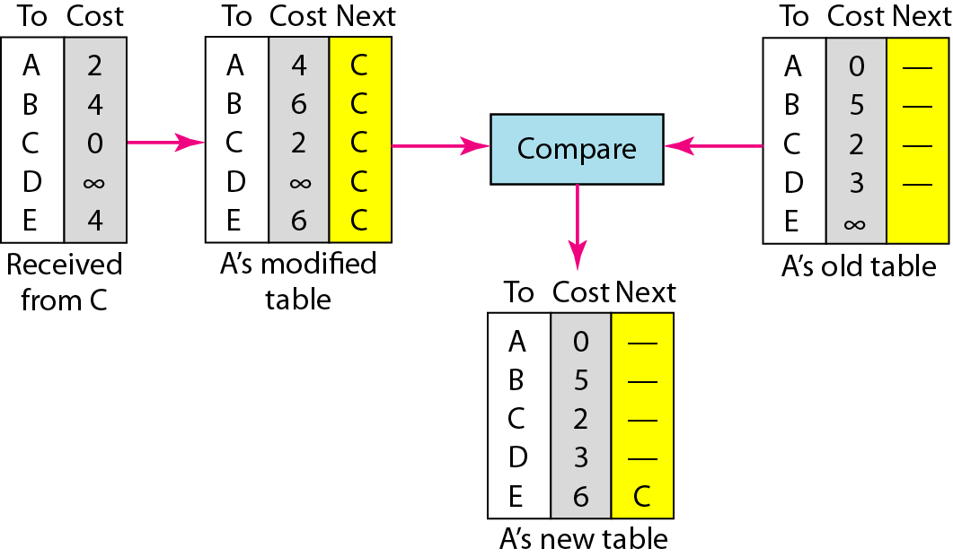
Updating in distance vector routing
Figure 7: updating Routing tables

Slide 20
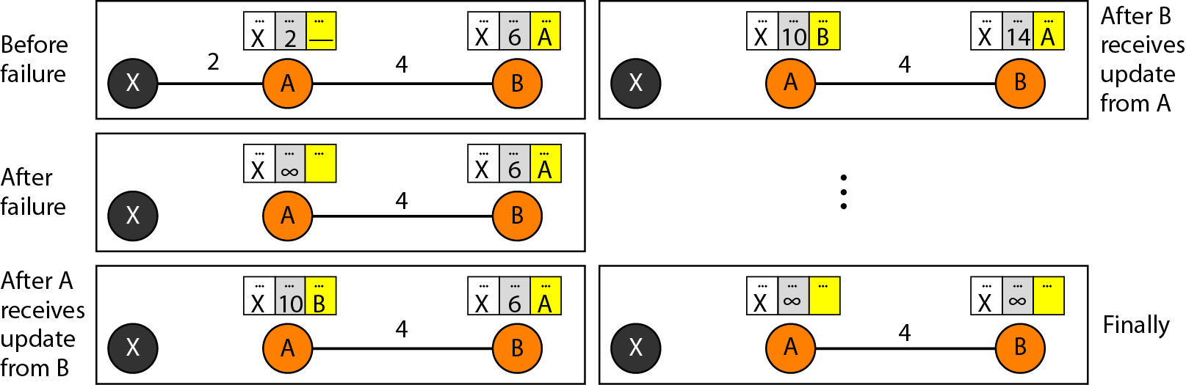
Two-node instability
Figure 8: Two-node instability

Slide 21
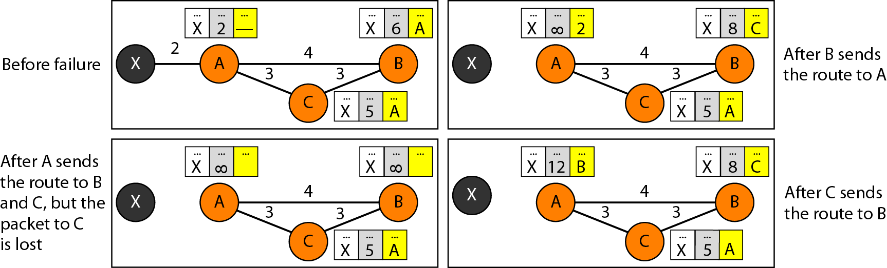
Three-node instability
Figure 9: Three-node instability

Slide 22
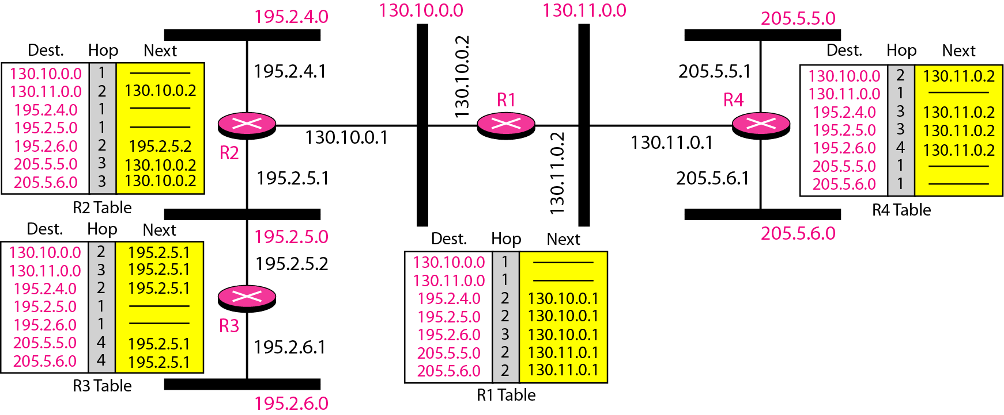
Example of a domain using RIP
Figure 10: RIP

Slide 23
5. Link State Routing
Link state routing is a technique in which each router shares the knowledge of its neighborhood with every other router in the internetwork.
While distance-vector routers use a distributed algorithm to compute their routing tables, link-state routing uses link-state routers to exchange messages that allow each router to learn the entire network topology.
Based on this learned topology, each router is then able to compute its routing table by using the shortest path computation.
Each router must do the following:
Discover its neighbors, learn their network address.
Measure the delay or cost to each of its neighbors.
Construct a packet telling all it has just learned.
Send this packet to all other routers.
Compute the shortest path to every other router.

Slide 24
Link State: Step by Step Details
Step 1: Learning about the Neighbors
Upon boot of router,
Send HELLO packet on each point-to-point line
Routers are supposed to send reply with a globally unique name
Step 2: Measuring the Line Cost:
Measure round-trip delay using ECHO Packet and wait for its reply
Take load into account? Yes. Arguments both ways: when choice is given to router having same number of hops from S to D.
Yes! preference for unloaded line as shortest path.
No! where oscillations are possible.
Better Solution? Distribute Load over multiple lines.

Slide 25
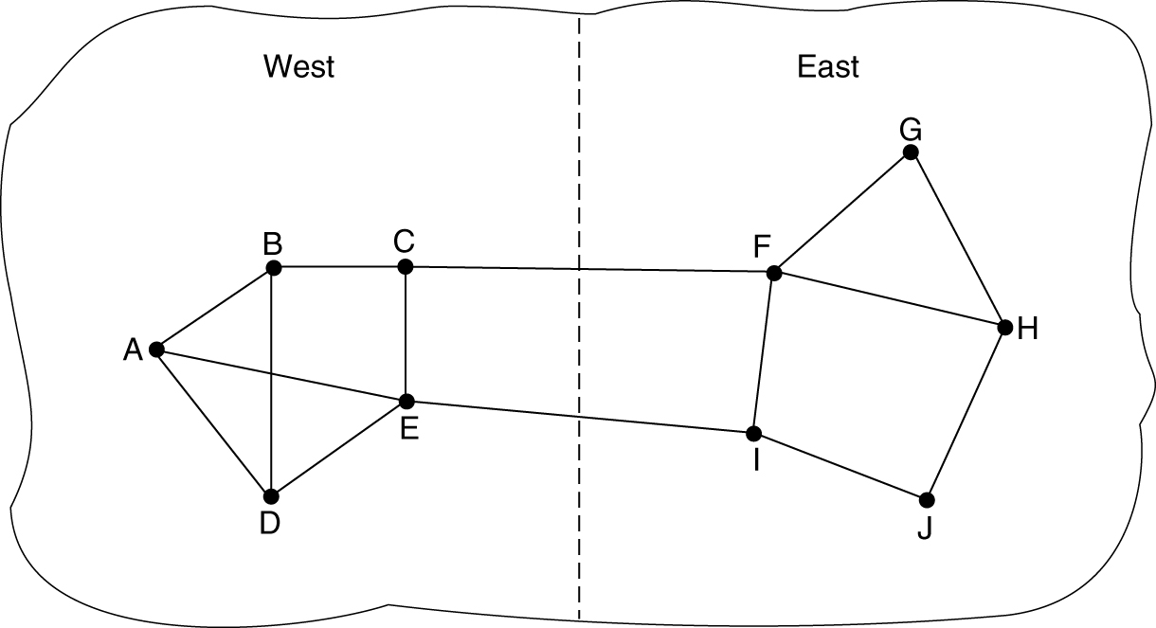
Measuring Line Cost
Figure 11: A subnet in which the East and West parts are connected by two lines.

Slide 26
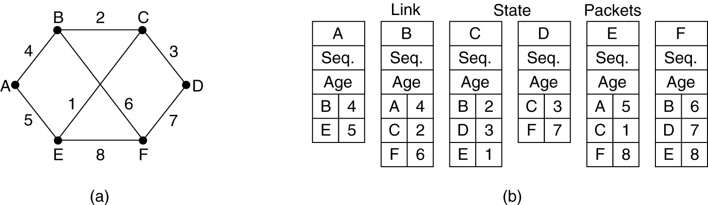
Link State: Step by Step Details
Step 3: Building Link State Packets:
Packet containing:
Identity of sender: Sequence number + age
For each neighbour : name + distance
When to build the link state packets?
Periodically
when significant events occur
Figure: 12 (a) A subnet. (b) The link state packets for this subnet.

Slide 27
Link State: Step by Step Details
Step 4: Distributing Link State Packets:
Distributing link state packets: Trickiest part of algorithm
Arrival time for packets different
How to keep consistent routing tables?
Basic algorithm: Flooding + Sequence number (in each packet) to limit duplicates.
Manageable problems
Wrap around of sequence numbers results to wrong data. Solution? Use 32 bit sequence number.
Wrong sequence number used in case of lost in case of crash and corrupted data transmitted.
Solution? include the age of each packet after the sequence number and decrement it once per second. When the age hits zero, the information from that router is discarded.

Slide 28
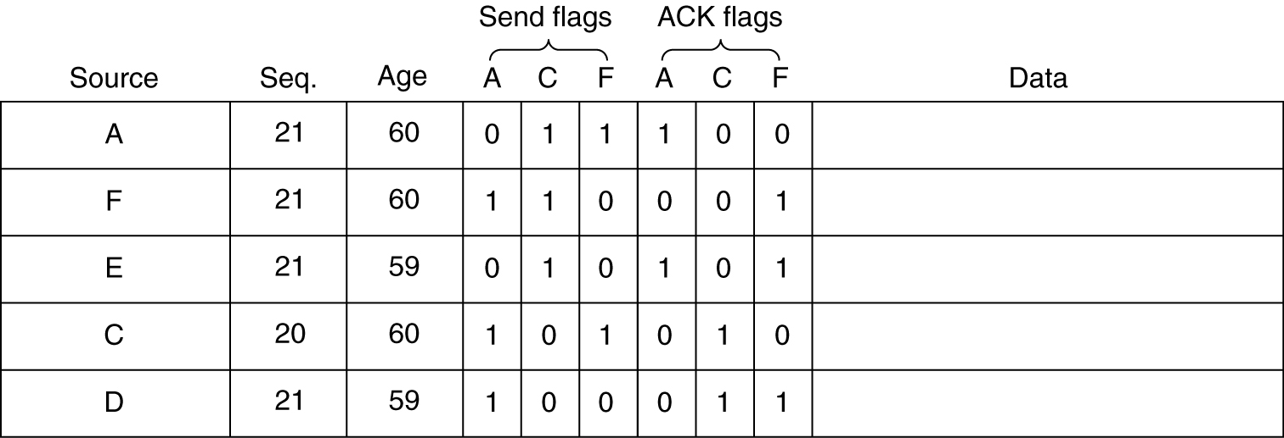
Distributing the Link State Packets
The packet buffer for router B in the previous slide.

Slide 29
Step 5: Computing new routes
With a full set of link state packets, a router can:
Construct the entire subnet graph
Run Dijkstra’s algorithm to compute the shortest path to each destination
Problems for large subnets
Memory to store data and more compute time for developing these tables.
Usage:
IS-IS protocol (Intermediate System, Intermediate System): Designed for DECnet(digital equipment corporation network protocol suite), adopted by ISO(international standardization organization), used still in internet and supports multiple network layer protocols
OSPF(Open Shortest Path First) protocol used in Internet. The Common features are:
Self-stabilizing method of flooding link state updates
Concept of a designated router on a LAN
Method of computing and supporting path splitting and multiple metrics.
Useful in Multi Protocol Environment.

Slide 30
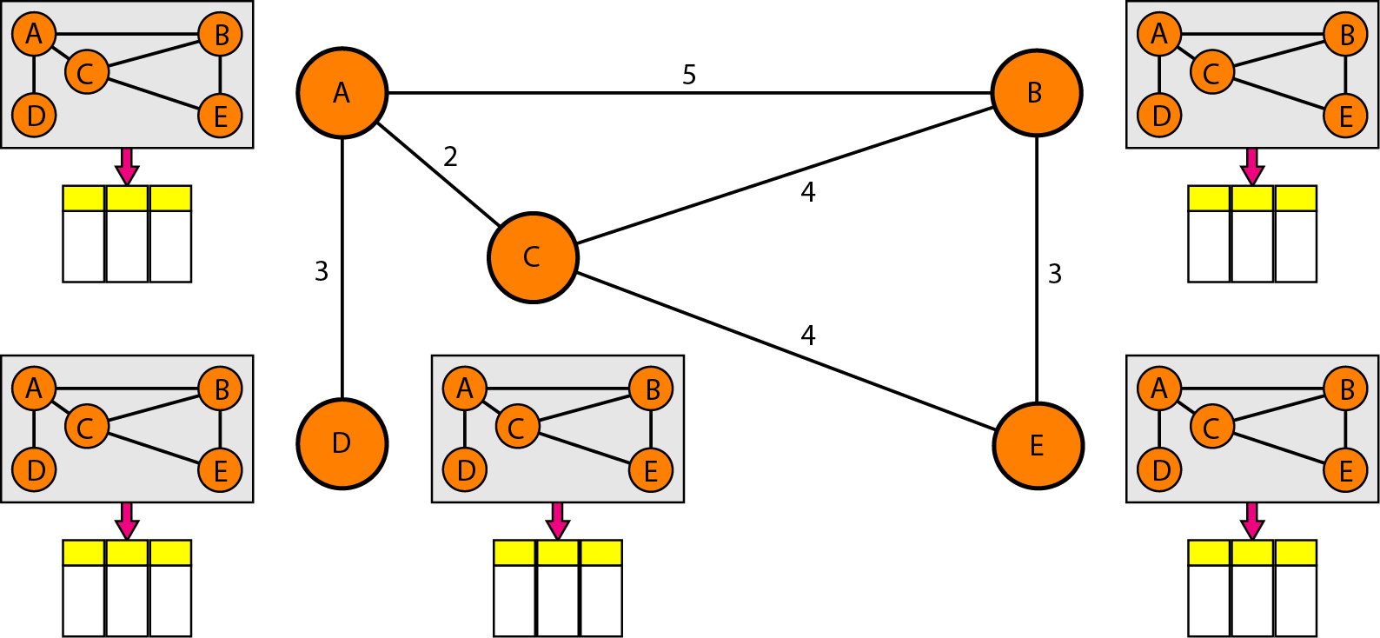
Concept of link state routing

Slide 31
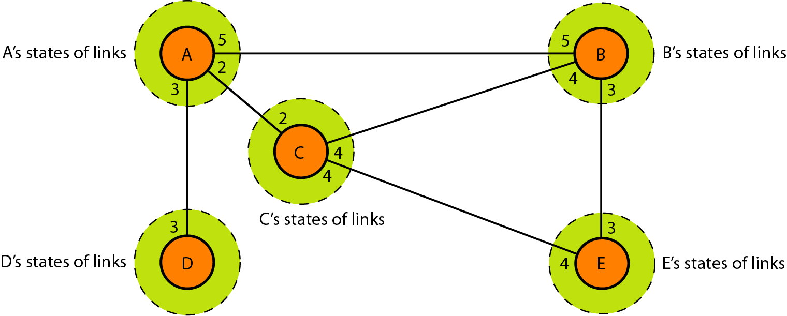
Link state knowledge

Slide 32
Difference between Link State and Distance Vector
Link State | Distance Vector
link states algorithm is an algorithm using global information | the distance vector algorithm is iterative, asynchronous, and distributed
each node talks with all other nodes, but tell them only the cost of it's directly comparison of some of their attribute | each node talks to only its directly connected neighbors, but provides its neighbor with least cost estimates from itself to all the nodes.
Message complexity: With link state, every node has to keep the information about the cost of each link within the network. | Message complexity: with distance vector algorithm, message is exchanged between two hosts which are directly connected to each other.
very times, if any of the link cost is changed, all the nodes are updated. | change of cost in the link which is belong to the least cost path for one of the nodes, the DV algorithm will update the new value. But if the change doesn't belong to the least cost part between 2 hosts, there will no updating.
Speed of convergence: can converge faster in comparison of later. | Speed of convergence: can converge slowly and have routing loops while the algorithm is converging.
Such probability is less. | DV algorithm also suffers from the count to infinity problem.
Robustness: For LS, when a router is down, it can broadcast a wrong cost for the closest one. LS node is computing for its own forwarding table and other node do the calculation for themselves. Better than DV. | Robustness: DV, the wrong least cost path can be passed to more than one or all of the node so the wrong calculation will be process in the entire net work. This problem of DV is much worse than LS algorithm.

Slide 33
Practice Questions
Which layer is responsible for taking an IP packet and preparing it for transmission over the communications medium?
a. Physical Layer b. Network Layer
b. Data link layer d. Transport layer
2. What is the term for splitting up an IP packet when forwarding it from one medium to another medium with a smaller MTU?
a. Encapsulation b. Fragmentation
b. Segmentation d. Serialization
3. Which statement is correct about IPv4 packet header fields?
The source and destination IPv4 addresses remain same while travelling from source to destination
Time to Live field is used to determine the priority of the each packet
Total length and header checksum fields are used to reorder a fragmented packet
The version field is used to identify the next level protocol

Slide 34
Practice Questions
4. Which field is used to detect corruption in the IPv4 header?
a. header checksum b. Time to live
c. Protocol d. Differentiated Services (DS)
5. Which statement about host forwarding decisions is true?
a. A host cannot ping itself
b. A remote destination host is on the same local network as the sending host
c. Local hosts can reach each other without the need of a router
d. Routing is enabled on switches to discover the best path to a destination
6. What does a code of “O” indicate next to a route in the routing table?
a. directly connected route b. a route with administrative distance of 0
c. gateway of last route d. a route learned dynamically from OSPF
7. This type of route is also known as a gateway of last resort-
a. static route b. default route
c. remote route d. directly connected route

